Slide 1
Tutorial-11
Implement SR flip-flop using NOR gates
(using both schematic and VHDL).
2. Implement JK flip-flop using schematic and VHDL.

Slide 2
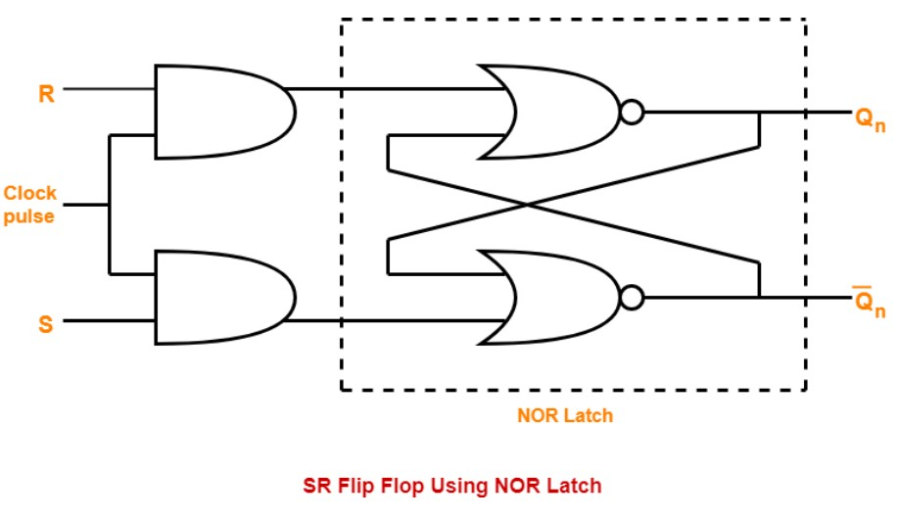
Schematic (SR-flipflop)

Slide 3
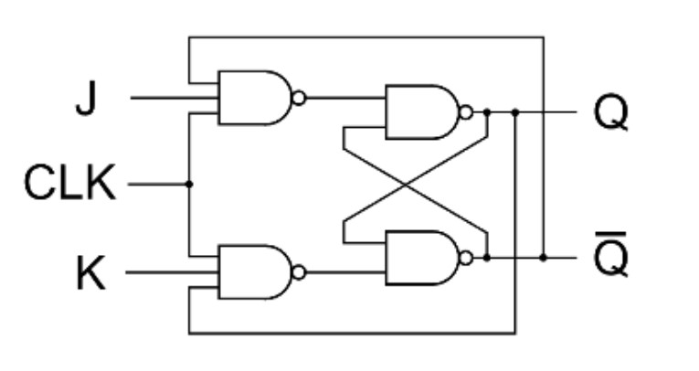
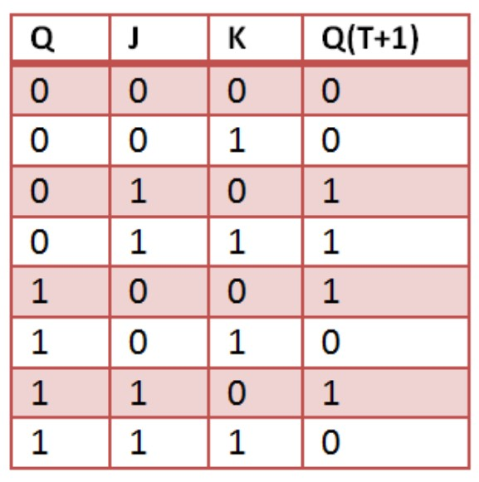
Schematic (JK-flipflop)

